Slide 1
ANOMALY BASED IDS USING ML
Final Year Project Review -1
Anand Ingle
Akshay Chacharkar
Vishal Potgante
Hitesh Tapdiya

Slide 2
Contents
Project Vision
Project Requirements
Flow Diagram
Software Tools
System Review

Slide 3
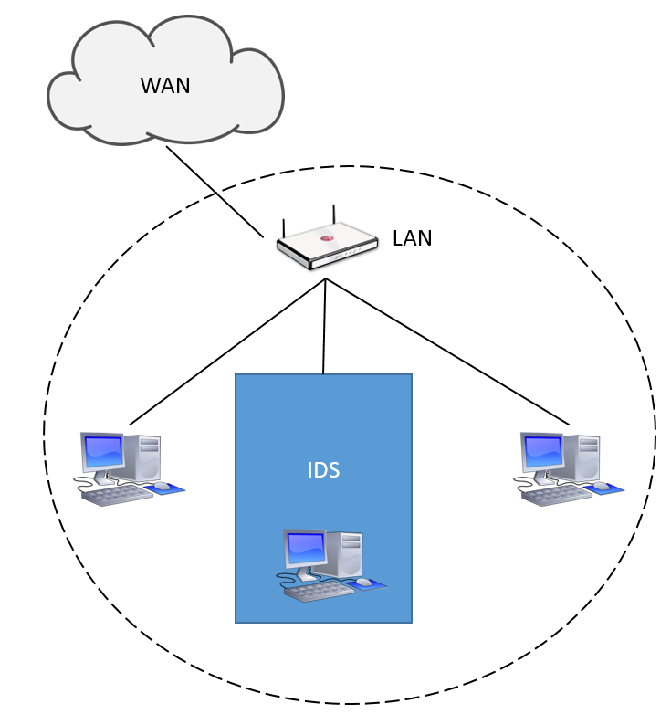
Project Vision
Intrusion Detection System
Unsupervised Anomaly based IDS
Host Based IDS
Read TCP/IP Packets
Detect Anomaly Traffic
Detect Zero day Attack
Logging System

Slide 4
Proposed Model:
Output
Network Traffic
IDS
Predict System
Input
Dataset
Feature Selection
Training
Trained Model
Predication

Slide 5
Project Requirement
The System shall be able to read data from the host system network card.
The system shall be able to interpret the data from the received network traffic and store it in a usable format.
The system shall be able to determine if the network data received by the host machine is malicious with at least 85% accuracy.
The system shall determine what type of attack is being made to the host network when malicious network traffic is found.
The system shall be able to train itself through backpropagation on know network traffic data.
The system shall be able to notify the User of the host system when a malicious attack is encountered.
The system shall be able to log all malicious attacks into a log file.

Slide 6
States Of Machine Development
1. Data Import
2. Data Grouping
3. Data Normalization
4. Machine Training
5. Machine Prediction
6. Plot Anomaly
7. Detect Location

Slide 7
Data Import
Read Network Traffic
Plot The IP address and Location of Source
Plot Anomaly
Data Grouping
Data Normalization
Train Machine
Predict Anomaly

Slide 8
Software Tools
Wireshark
Spyder
Jyputer
Language’s And Framework
Python 3.6
Pandas
Plotly
Numpy
Flask, HTML Javascript and CSS

Slide 9
Phase 2.0
1. Design UI
2. Predict Location
3. Log Data
4. Live Tracking

